Slide 1
Java
Reem Jarrar

Slide 2
Course Schedule
 | March
Su | Mo | Tu | We | Th | Fr | Sa
 |  |  |  |  | 1 | 2
3 | 4 | 5 | 6 | 7 | 8 | 9
10 | 11 | 12 | 13 | 14 | 15 | 16
17 | 18 | 19 | 20 | 21 | 22 | 23
24 | 25 | 26 | 27 | 28 | 29 | 30
31
 | April
Su | Mo | Tu | We | Th | Fr | Sa
31 | 1 | 2 | 3 | 4 | 5 | 6
7 | 8 | 9 | 10 | 11 | 12 | 13
14 | 15 | 16 | 17 | 18 | 19 | 20
21 | 22 | 23 | 24 | 25 | 26 | 27
28 | 29 | 30
 | May
Su | Mo | Tu | We | Th | Fr | Sa
28 | 29 | 30 | 1 | 2 | 3 | 4
5 | 6 | 7 | 8 | 9 | 10 | 11
12 | 13 | 14 | 15 | 16 | 17 | 18
19 | 20 | 21 | 22 | 23 | 24 | 25
26 | 27 | 28 | 29 | 30 | 31
Midterms

Slide 3
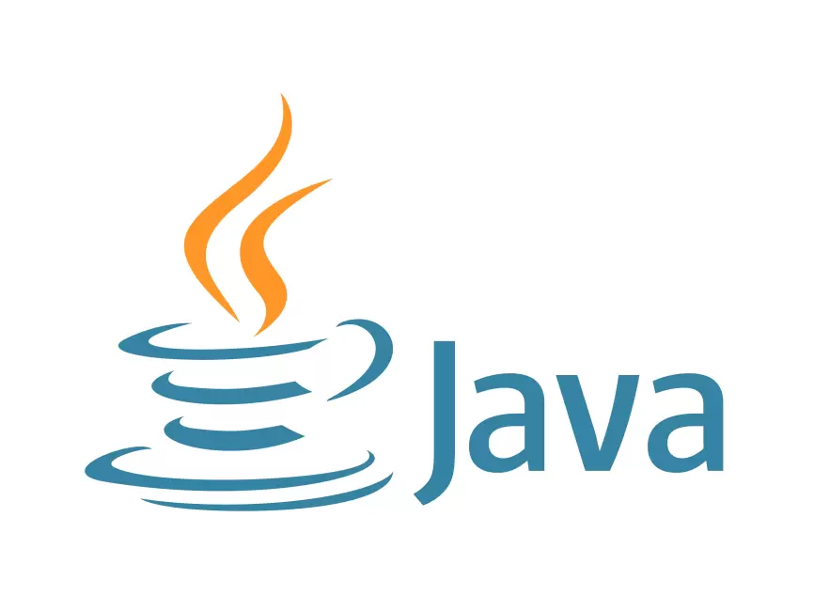
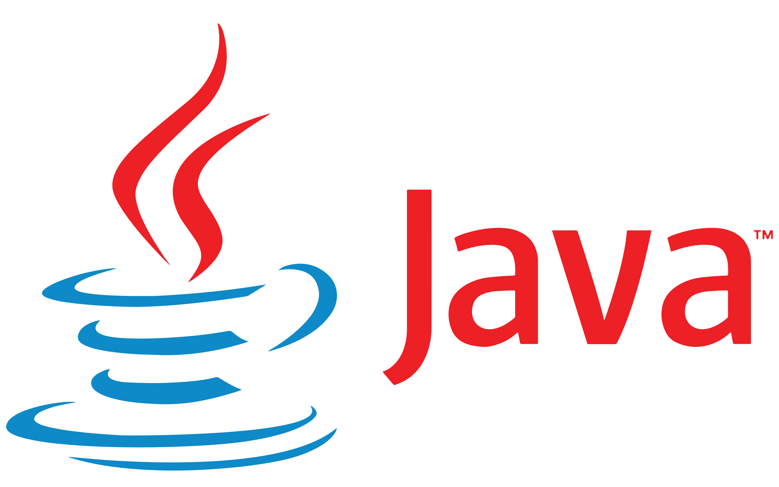
Java is the name of an island in Indonesia where the first coffee(named java coffee) was produced. And this name was chosen by James Gosling while having coffee near his office. Note that Java is just a name, not an acronym.

Slide 4
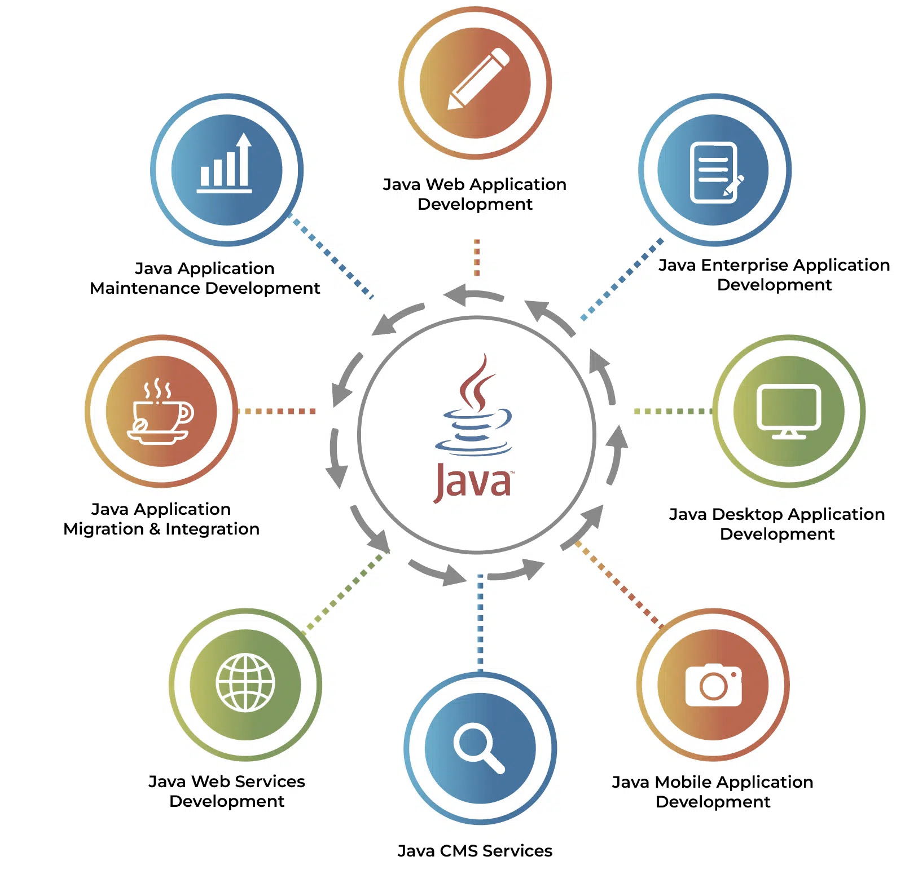
Java Applications

Slide 5
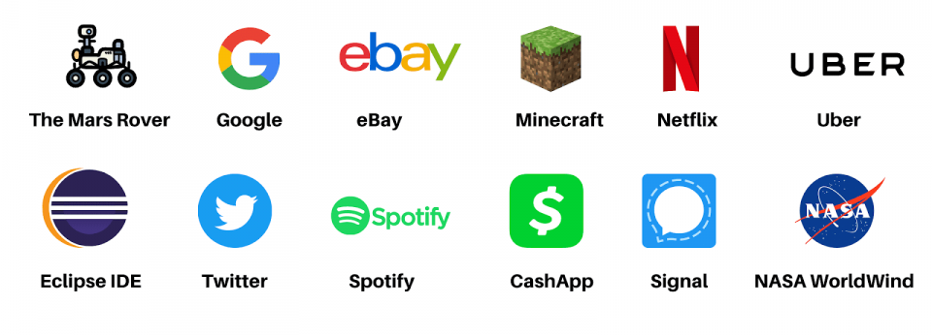
Java Application Examples

Slide 6
Concepts

Slide 7
Java Runtime Environment (JRE):
Java Development Kit(JDK)
JDK includes JRE.
JRE installation on our computers allows the java program to run, however, we cannot compile it. JRE includes a browser, JVM, applet support, and plugins. For running the java program, a computer needs JRE.
Is a complete Java development kit that includes everything including compiler, Java Runtime Environment (JRE), java debuggers, java docs, etc. For the program to execute in java, we need to install JDK on our computer in order to create, compile and run the java program

Slide 8
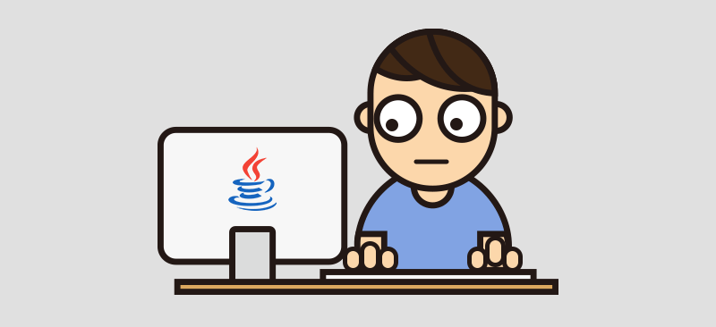
Java Virtual Machine(JVM)
There are three execution phases of a program
Writing
Compiling
Running
Done by a java programmer like me and hopefully you
Done by the JAVAC compiler which is a primary Java compiler included in the JDK. It takes the Java program as input and generates bytecode as output.
JVM executes the bytecode generated by the compiler

Slide 9
Bytecode
As discussed, the Javac compiler of JDK compiles the java source code into bytecode so that it can be executed by JVM. It is saved as .class file by the compiler.

Slide 10
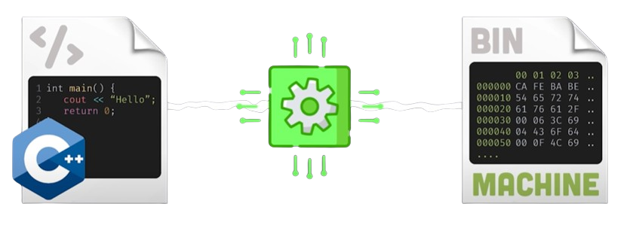
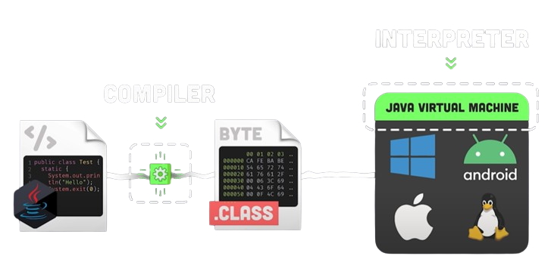
What made Java innovative is that instead of compiling to machine code like C or C++, it compiles to byte code that can run on any Operating System without recompiling which is made possible by executing the code with JVM
It is both a Complied and Interpreted Language at the same time
The computer just needs to have the JRE

Slide 11
Why is Java good?
01
03
05
02
04
06
Platform
Independent
Secure
Robust
Pure OOP
Garbage Collection
Simple

Slide 12
Let’s download stuff

Slide 13
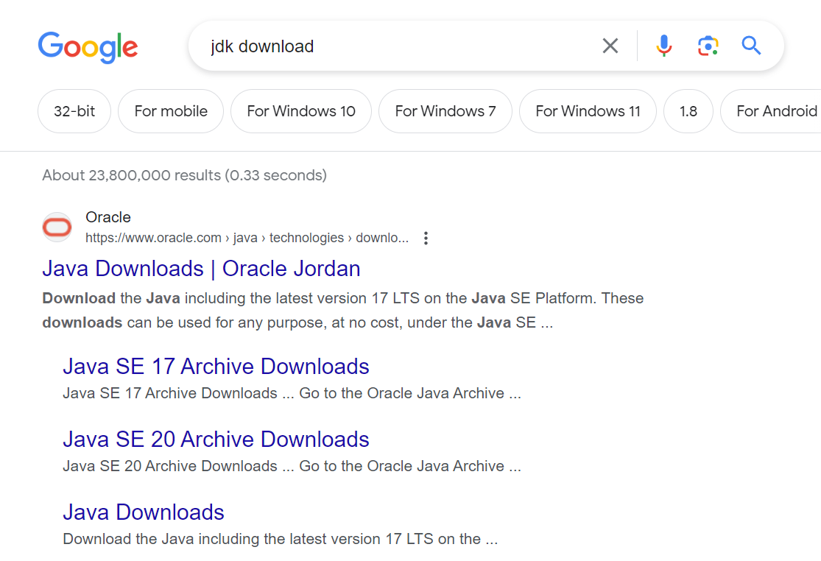

Slide 14
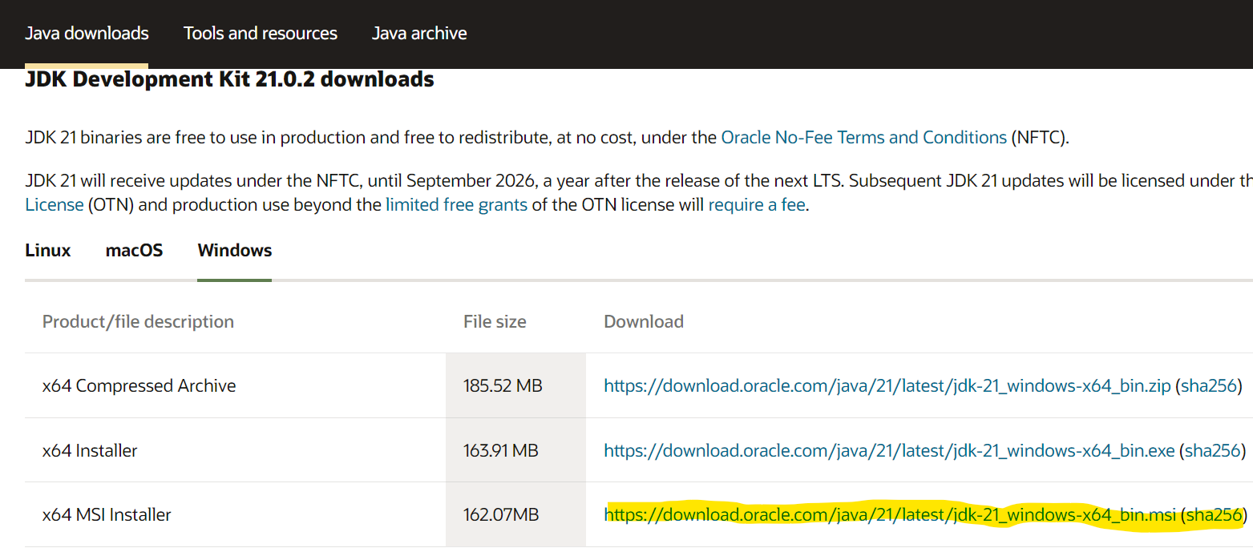

Slide 15
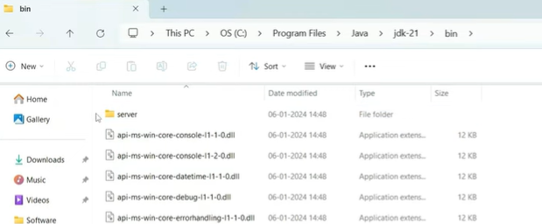

Slide 16
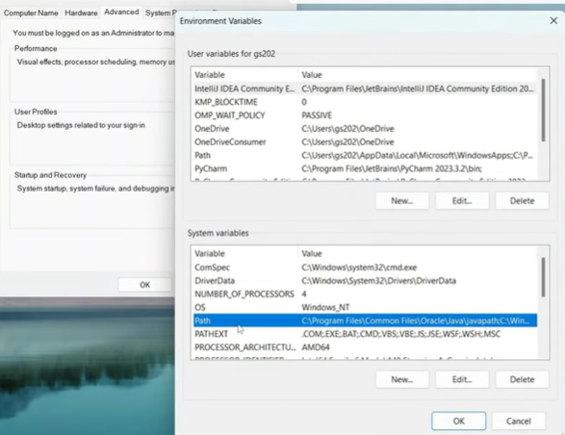

Slide 17
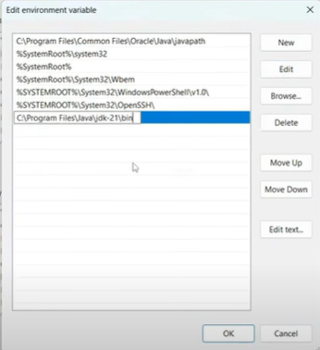

Slide 18
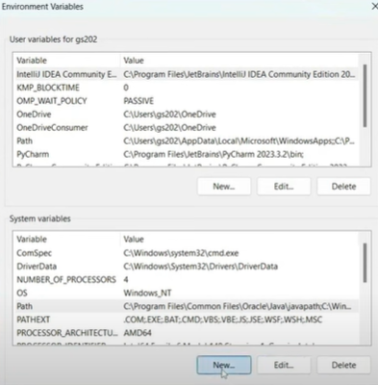

Slide 19
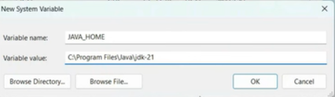

Slide 20
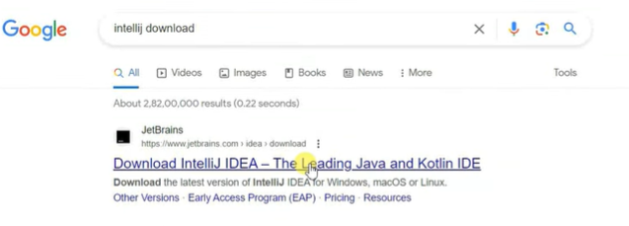

Slide 21
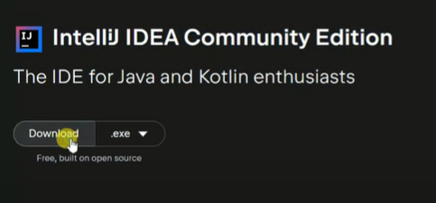

Slide 22
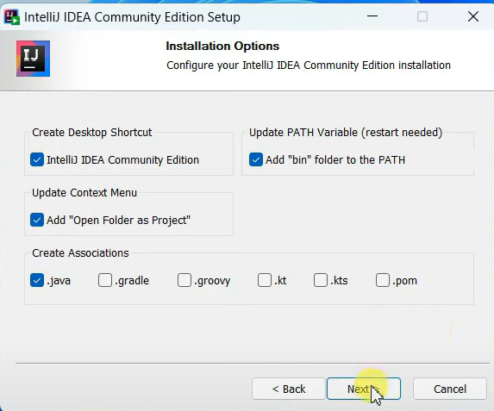

Slide 23
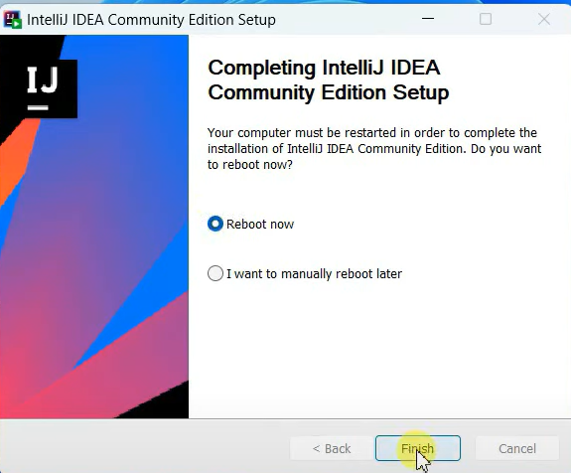

Slide 24
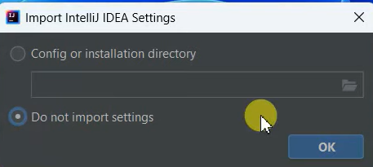

Slide 25
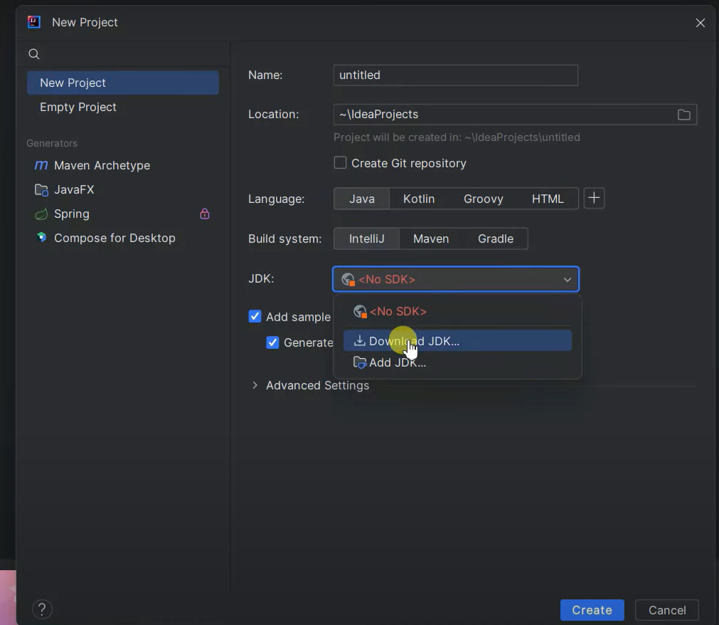

Slide 26
